Slide 1
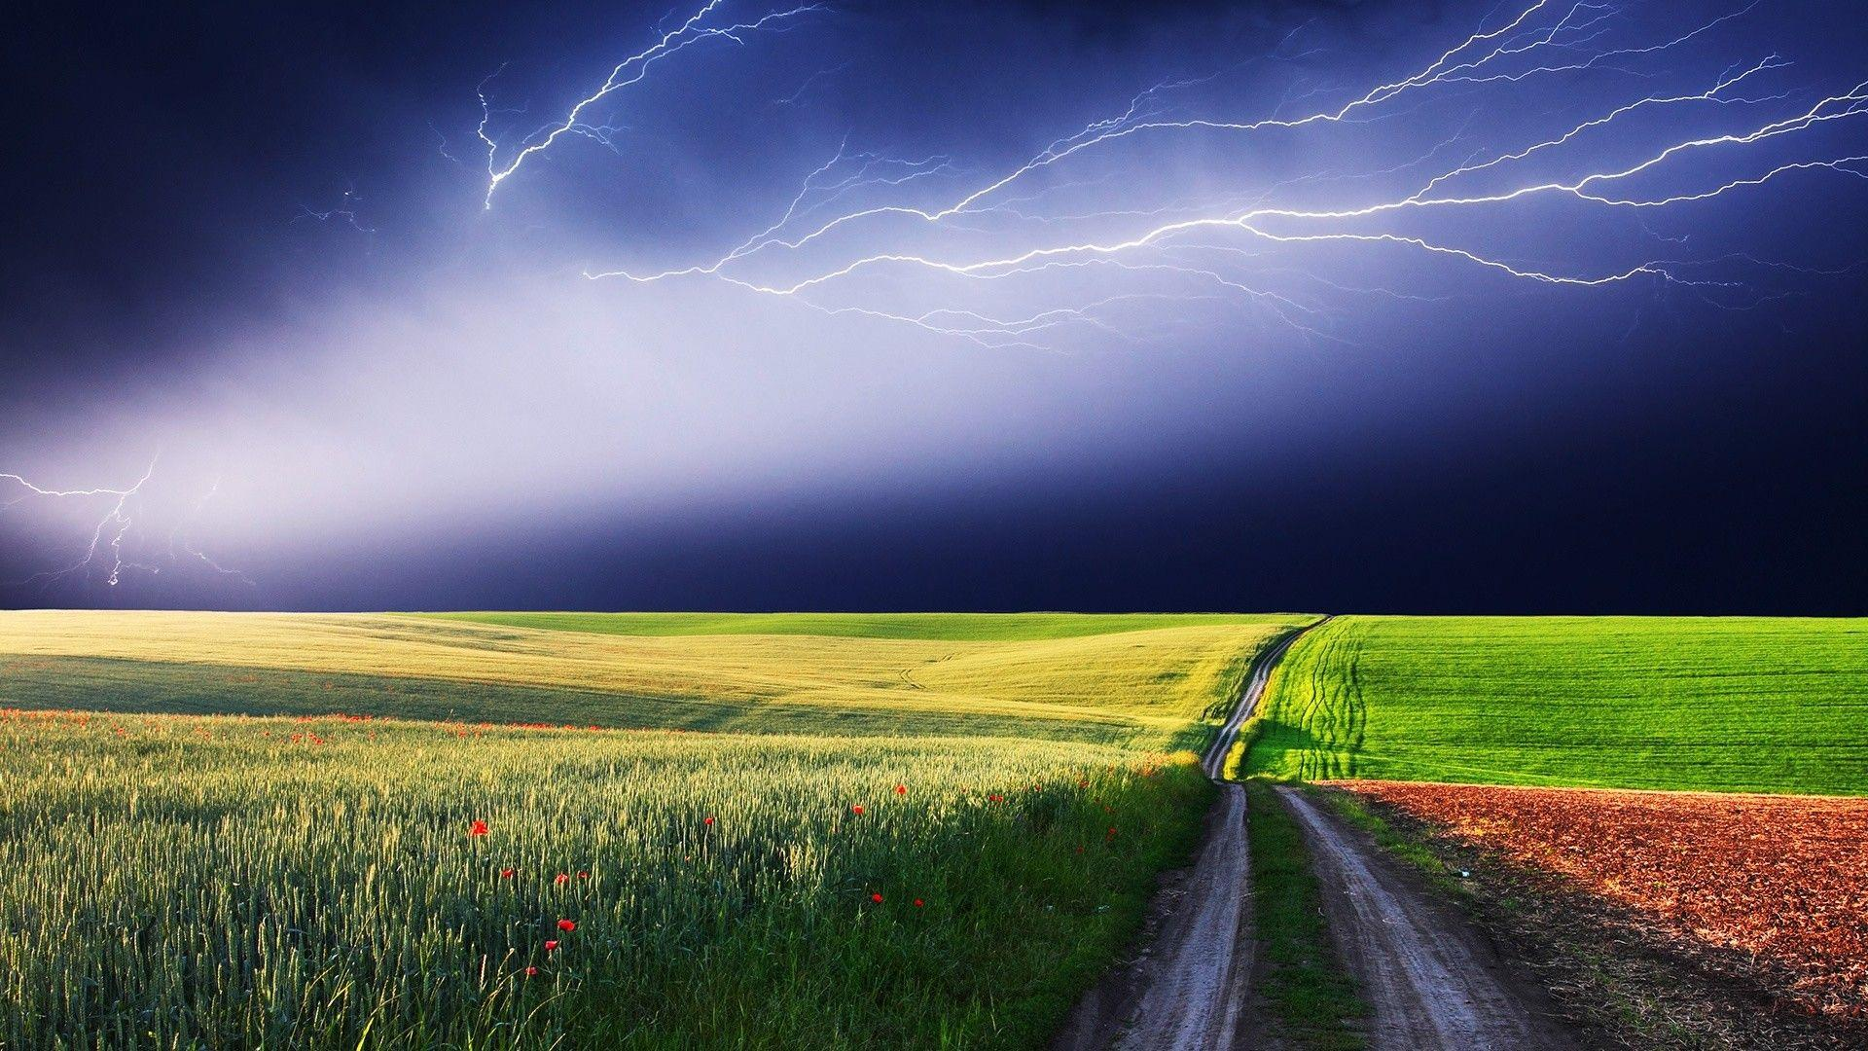
Weather prediction
Done by 42,55,58

Slide 2
Robert FitzRoy The Inventor of the Weather Forecast Robert FitzRoy, a British naval officer, is considered the first person to have invented the weather forecast in the 1860s. He established a system for gathering meteorological data and using it to predict the weather, which was a revolutionary idea at the time
Joseph Henry
The Father of Weather Forecasting Joseph Henry

Slide 3


INTRODUCTION
Weather forecasting is used for science and technology
to forecast atmospheric conditions for a certain place
and period. For centuries, people have tried to forecast
the weather informally, and officially since the nineteenth century.
Weather forecasting, which used to be done by hand
and was focused mostly on variations in barometric
Pressure , existing weather patterns, and sky state or
cloud cover, is now done using computer-based
model that account for a variety of atmospheric variables.
Human feedback is also required to choose the best possible
forecast model on which to base the forecast.
Weather forecasting is a part of the economy

Slide 4




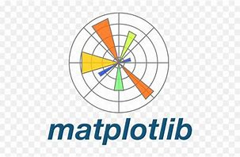
LIBRARY
Warnings
numpy
pandas
Matplotlib.pyplot
sklearn

Slide 5
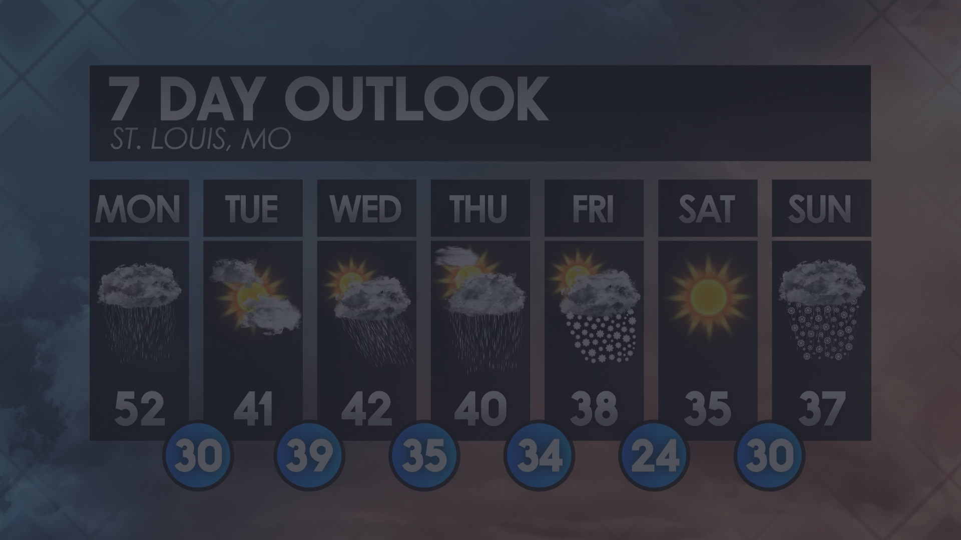
METHODOLOGY
1
2
3
Short-range
Medium-range
Long-range
Forecasts for the next few hours to a couple of days, using real-time data and models.
Forecasts for the next few days to a couple of weeks, relying on global weather models.
Forecasts for the next month to a season, based on statistical analysis and climate patterns.

Slide 6

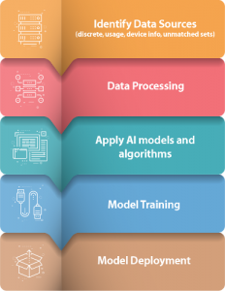
STEPS INVOLVED IN PROJECT
1 . Importing the libraries
2 . Data Collection
3 . Data preprocessing
4 . Model Selection
5 . Training and validation
6 . Evaluation
7 . Validation
8. Deployment

Slide 7

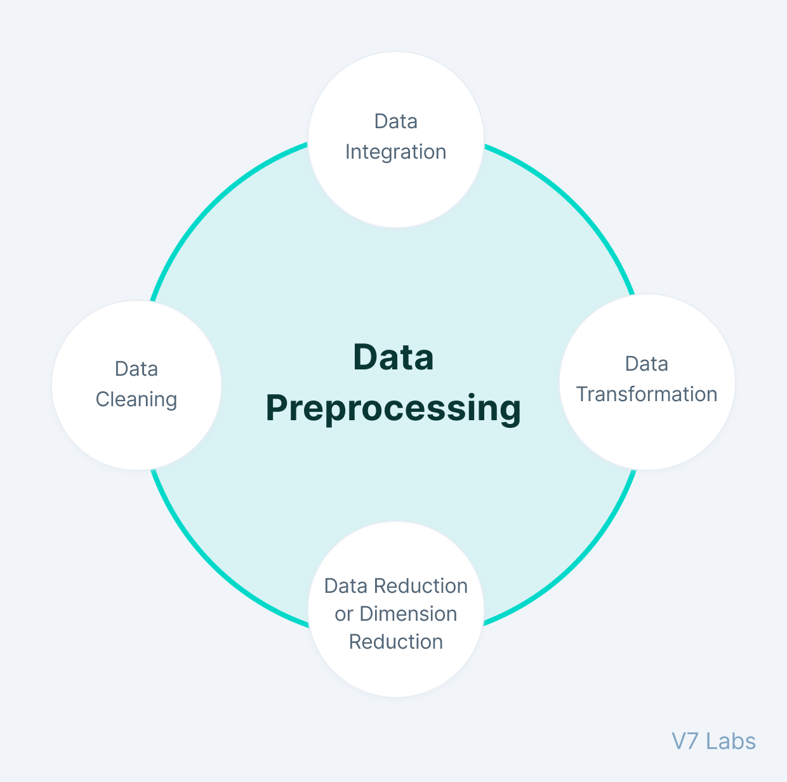
1 . Importing the Libraries : As you have already seen the libraries we have
imported like pandas , numpy , matplotlib.pyplot
and sklearn.
2 . Data collection : We have collected our data from online like chat - gpt or
other ai platform . Our data is based on weather of
Kanpur city in which how we have predicted would seen in
the upcoming slides.
3 . Data preprocessing : Data preprocessing is a critical step in machinelearning (ML)
where raw data is transformed into a format that is suitable
for model training. It involves cleaning,transforming, and
organizing data to make it usable for ML algorithms.

Slide 8

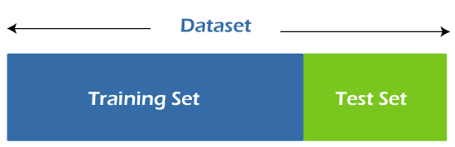
4 . Model Selection : Choose the appropriate ML algorithms or models based on the
problem type (e.g., classification, regression, clustering) and data
characteristics.
5 . Training and Validation : Train the selected models on the training dataset
using appropriate training techniques . Here the
training data set -80% and testing data set – 20%
(e.g., gradient descent, backpropagation).
80% 20%

Slide 9

6 . Evaluation : Evaluate the trained models using suitable evaluation metrics
(e.g., accuracy, precision, recall, F1-score, ROC-AUC) on validation or
cross-validation datasets to assess their performance.
7 . Validation : Validate the final model(s) on a separate test dataset to estimate their
real-world performance and generalization ability.
8 . Deployment : Deploy the trained model into production, ensuring it can handle
real-time data and integrate seamlessly with existing systems.

Slide 10

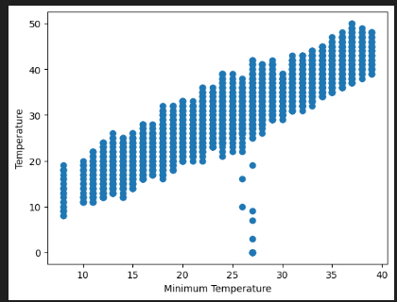
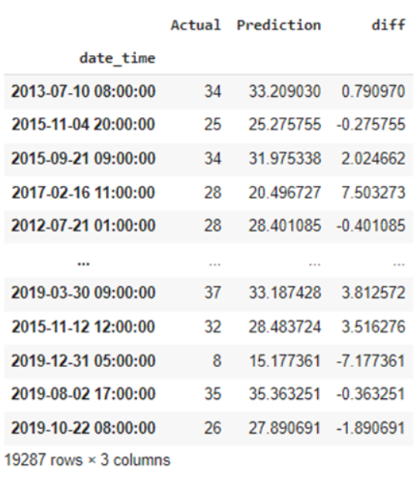
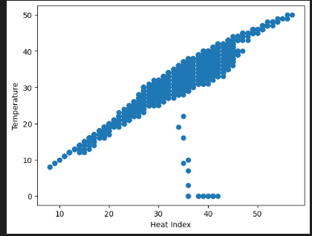
ALGORITHM
1 . LINEAR REGRESSION :
This regression model has high mean absolute error
hence turned out to be the least accurate model.

Slide 11

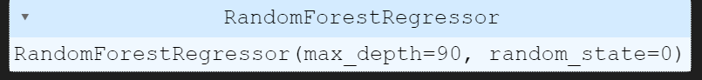
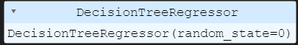
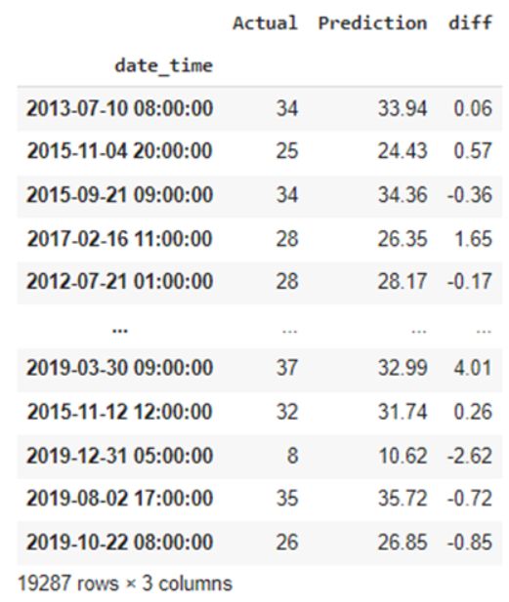
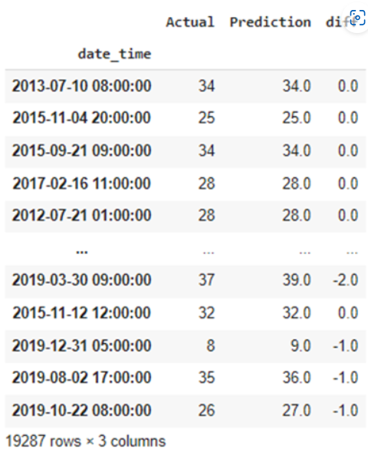
2 . RANDOM FOREST REGRESSION:
3 . DECISION TREE REGRESSION:
This regression model has low mean absolute error
hence turned out to be the more accurate model.
This regression model has medium mean absolute error hence turned out to be the little accurate model.

Slide 12

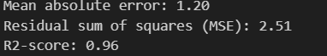
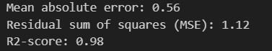
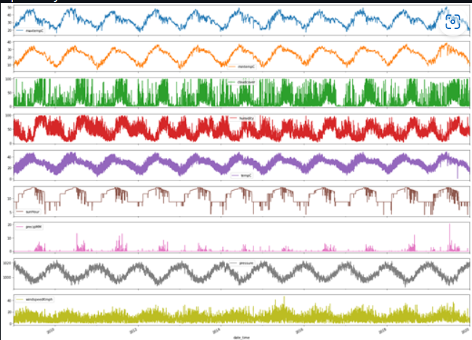
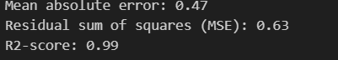
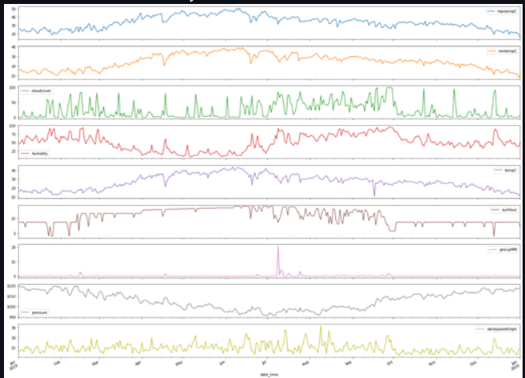


RESULT
R-2 SCORE OF LINEAR REGRESSION
R-2 SCORE OF DECISION TREE
REGRESSION
Plot for each factor for 1 year
R-2 SCORE OF RANDOM FOREST
REGRESSION
Variance score of LR
Variance score of DTR
Variance score RFR
Plot for each factor for 10 year

Slide 13

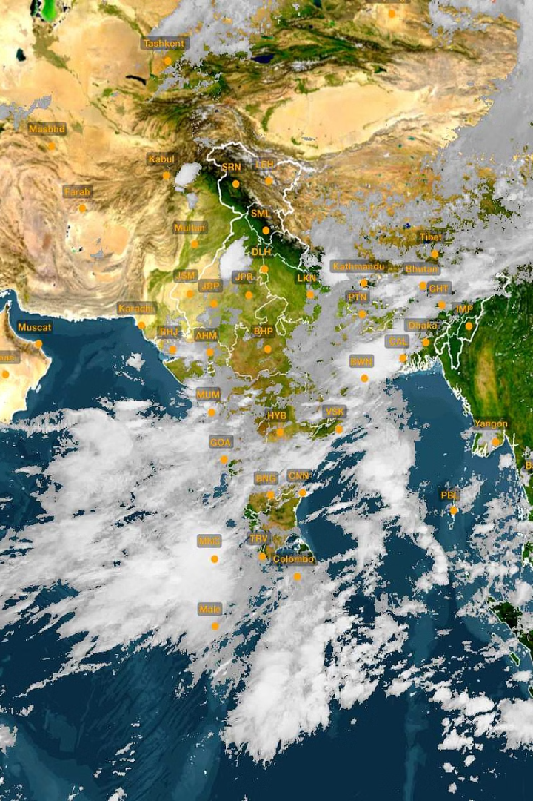
WEATHER CHALLENGES
Weather challenges include the complexity of forecasting, communication of forecasts, and the intensification of extreme events due to climate change.
Climate change is primarily caused by human activities, such as burning of fossil fuels, deforestation, agriculture, and land-use changes, which increase the amount of 'heat-trapping' greenhouse gases in the atmosphere
Extreme events like floods, wildfires, and storms pose significant threats, requiring improved forecasting and preparedness measures.

Slide 14



FUTURE SCOPE
Higher-resolution imagery and advanced sensors will enhance our ability to monitor global weather patterns.
Improved Satellite Technology
Artificial Intelligence
Machine learning algorithms can analyze vast amounts of data to identify patterns and improve forecast accuracy.
Ensemble Modeling
Higher computing power allows for running weather models at finer resolutions, providing more detailed and accurate forecasts for specific locations and timeframes.
Citizen Science
citizen science in weather prediction holds immense potential for the future, offering opportunities public in enhancing forecasting capabilities, improving data quality, and fostering community resilience to weather-related challenges.

Slide 15

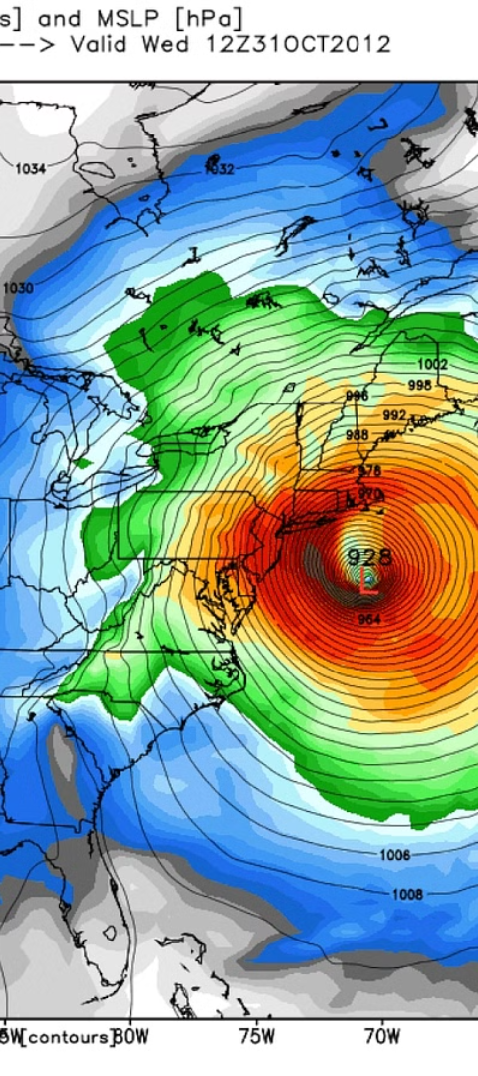
CONCLUSION
In conclusion, weather forecasts have become increasingly accurate and useful, with advancements in data collection, computational power, and understanding of physical processes resulting in more skillful forecasts across diverse meteorological phenomena. While there are still limitations to predictability, particularly for smaller and shorter-lived events and at longer lead times, weather forecasts play a critical role in reducing weather-related losses and enhancing societal benefits.

Slide 16


